Slide 1
OGC-Preview / Feature Browser User Guide
A brief overview on OGC Preview/Feature Browser’s user interface

Slide 2
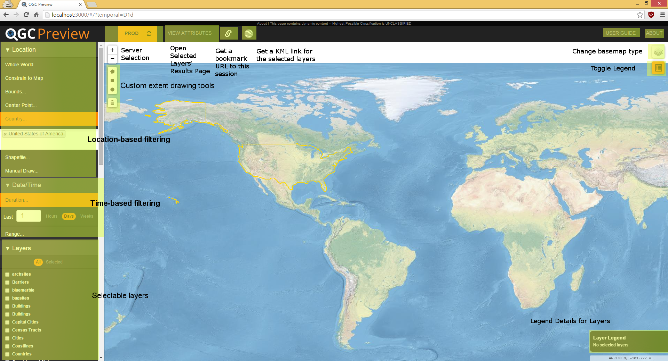
Main Interface

Slide 3
Interface Explained
Header Controls
Server Controls
Configured server names will be displayed. By default, all configured servers will be turned on and highlighted as to be shown as “active.” Clicked the name of the server will turn it on and off. Clicking the refresh button next to the server name will force a refresh of all the layer data associated with that server.
View Attributes
This pops up a results window to get further information on the selected layer’s attributes for exporting data for further analysis.
User Guide
You’ve found it, or here’s another way to get to where you are now.
About
Find the contact details to give us some helpful feedback!
Application State Link
This button will generate a shareable link to your current application’s state. It will preserve selected layers and filters.
KML Links
This button will generate KML file for the layers selected. If more than one server’s layers are selected, a link for each server will be generated for use outside the tool.

Slide 4
Interface Explained
Sidebar Controls
Filters
Location – select one of the following at a time:
Whole World
Default to querying based on the entire map of the world (returns all results of all enabled layers)
Constrain to map
Limit the results to the current map’s zoom state
Bounds
Input specific North, East, South, and West coordinates to draw a bounding rectangle for filtering.
Center Point
Select a center point in lat/long and a distance to make a bounding rectangle for filtering.
Country
Select one or multiple countries to filter on.
Shapefile
Upload a region shapefile to filter on.
Manual Draw
Drawing tools are provided hovering on the map – you can manual draw polygons and circles.
Date/Time
A variety of filters will be developed for managing the amount of data displayed. Currently, date and time filtering is possible via a duration or a range selector.
Layer Selection
A listing of available geospatial layer information will be displayed with a checkbox. Checking the box turns the layer’s information display on and off.

Slide 5
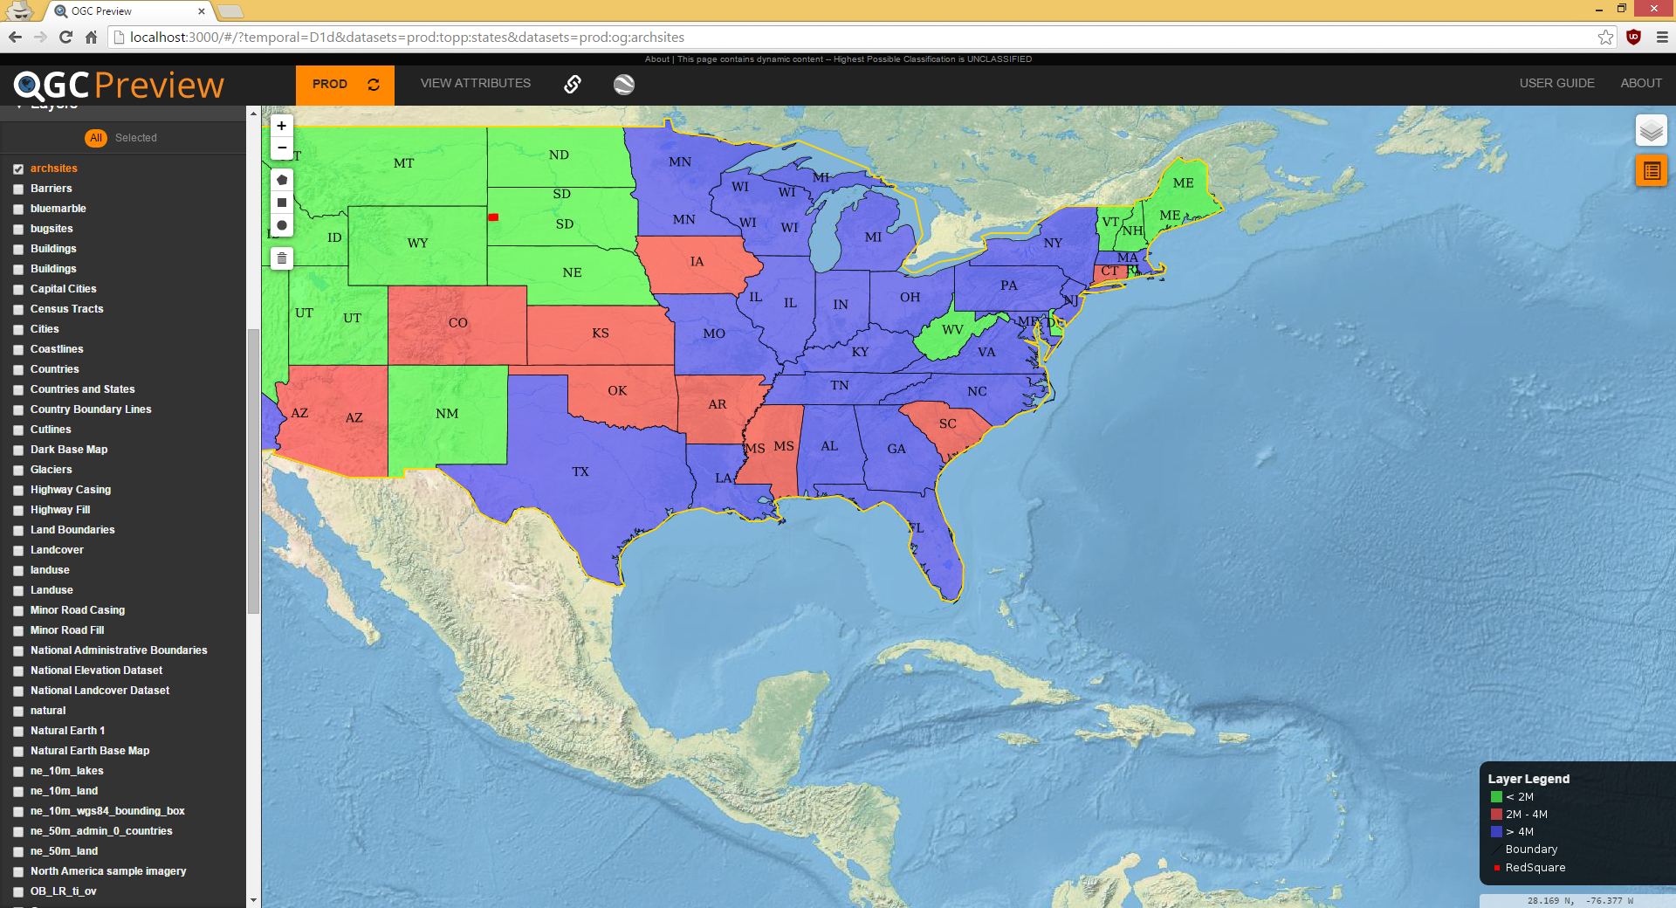
Selected Layers

Slide 6
Selected Layers
Selecting layers on the left hand side bar causes the layers to appear on the map.
In the previous screen, several layers are selected and their associated legend information is displayed in the bottom right corner.
A bounding region is created via the attribute selection tool.
In the previous screen, you can also see that the URL is updated to preserve the current filter and layer display. You can use this feature to share your state or save the URL to come back later.

Slide 7
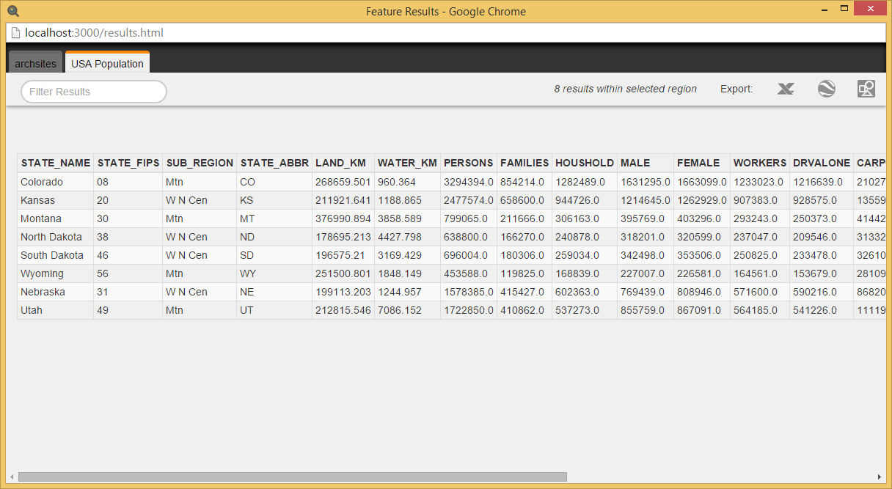
Viewing Attributes

Slide 8
Viewing Attributes
After my selection, I hit “View Attributes.”
This caused a popup as shown on the previous slide displaying the two layers I had selected that are inside the region I made.
Here you can view feature information as well as export the information in a variety of formats: CSV, KML, and SHP files.
You can also further filter the results based on text/name.

